Slide 1
Middle Earth Fantasy Day Infographics
Here is where this template begins

Slide 2
About Middle Earth Fantasy
Day infographics
This template contains an assortment of complementary infographic resources for the Middle Earth Fantasy Day presentation
These infographics are adapted to the style of the aforementioned presentation, so you can insert them easily and have them completely integrated at once. You just need to do the following:
Select the element that you want to copy
Right-click and choose “Copy”
Go to the slide where you want the element to appear
Right-click and choose “Paste”

Slide 3
Middle Earth Fantasy Day infographics
Mercury
Venus
It’s the smallest planet of them all
It’s the second planet from the Sun
Jupiter
Mars
Jupiter is an enormous planet
Despite being red, Mars is cold

Slide 4
Middle Earth Fantasy Day infographics
Venus
Mars
Jupiter
Saturn
Venus has high temperatures
Despite being red, Mars is cold
It doesn’t have a solid surface
It’s a gas giant and has rings

Slide 5
Middle Earth Fantasy Day infographics
01
Mars
03
Jupiter
Despite being red, Mars is very cold
Jupiter is the biggest planet of them all
Venus
02
Saturn
04
Venus is the second planet from the Sun
Saturn was named after a Roman god

Slide 6
Middle Earth Fantasy Day infographics
Mars
25%
Despite being red, Mars is cold
Jupiter
Venus
50%
Jupiter is an enormous planet
It has a beautiful name and is the second planet from the Sun
Saturn
75%
It’s a gas giant and has rings

Slide 7
Middle Earth Fantasy Day infographics
01
02
03
04
Venus
Mars
Jupiter
Saturn
Venus is a very hot planet
Despite being red, Mars is cold
Jupiter is an enormous planet
It’s a gas giant and has rings

Slide 8
Middle Earth Fantasy Day infographics
 | Genre | Description
Book 1 | Jupiter | Jupiter is a gas giant
 | Venus | Venus is a hot planet
Book 2 | Saturn | Saturn is a gas giant
 | Neptune | Neptune is an ice giant
Book 3 | Earth | We all live on Earth
 | Mars | Mars is made of basalt

Slide 9
Middle Earth Fantasy Day infographics
Venus
It’s the second planet from the Sun
Mercury
It’s the smallest planet of them all
Mars
Despite being red, Mars is cold

Slide 10
Middle Earth Fantasy Day infographics
80%
50%
30%
Venus
Mercury
Jupiter
It has a beautiful name and is the second planet from the Sun
It’s the closest planet to the Sun and the smallest of them all
Jupiter is a gas giant and the biggest planet in the Solar System

Slide 11
Middle Earth Fantasy Day infographics
45%
25%
30%
Venus
Mercury
Jupiter
It has a beautiful name and is the second planet from the Sun
It’s the closest planet to the Sun and the smallest of them all
Jupiter is a gas giant and the biggest planet in the Solar System

Slide 12
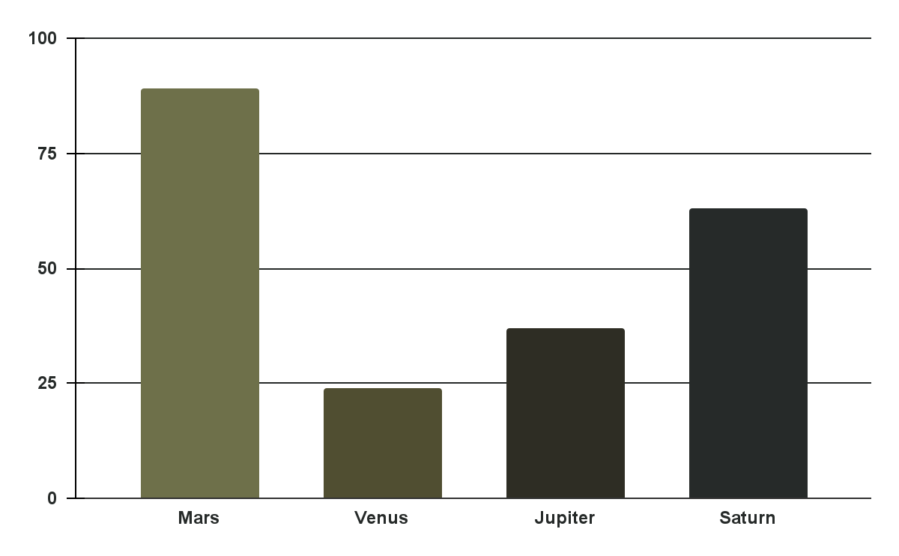
Middle Earth Fantasy Day infographics
Mars
Mars is a cold planet
Venus
Venus is a very hot planet
Jupiter
Jupiter is a big planet
Saturn
Follow the link in the graph to modify its data and then paste the new one here. For more info, click here
Saturn has several rings

Slide 13
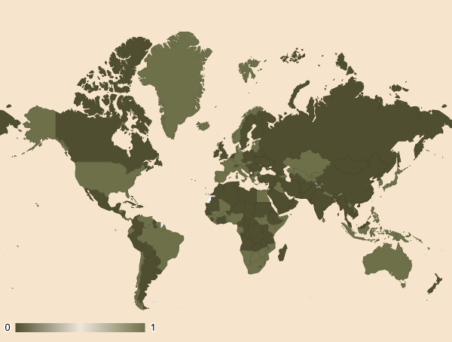
Middle Earth Fantasy Day infographics
Venus
Mercury
It has a beautiful name and is the second planet from the Sun
It’s the closest planet to the Sun and the smallest of them all
Follow the link in the map to modify its data and then paste the new one here. For more info, click here

Slide 14
Middle Earth Fantasy Day infographics
Option 1
Option 1
Venus has a beautiful name and is the second planet from the Sun
Option 2
Option 2
Jupiter is a gas giant and the biggest planet in the Solar System

Slide 15
Middle Earth Fantasy Day infographics
Mercury
Venus
It’s the smallest planet of them all
It’s the second planet from the Sun
Jupiter
Mars
Jupiter is an enormous planet
Despite being red, Mars is cold

Slide 16
Middle Earth Fantasy Day infographics
Books | Pages | Genre | Author | Sales
Venus | 1,003 | Neptune | Timmy Jimmy | 899,222
Mars | 728 | Earth | Carl Bed | 278,982
Jupiter | 398 | Moon | Anna Janna | 80,882
Saturn | 502 | Pluto | Susan Bold | 173,819

Slide 17
Middle Earth Fantasy Day infographics
Venus
Venus has a beautiful name and is the second planet from the Sun
Jupiter
Jupiter is a gas giant and the biggest planet in the Solar System

Slide 18
Middle Earth Fantasy Day infographics
Fiction
Nonfiction
Venus is a very hot planet
Mercury is a small planet
We all live on Earth
Mars is made of basalt
Jupiter is a big planet
Saturn is a gas giant
Neptune is an ice giant
Pluto is a dwarf planet

Slide 19
Middle Earth Fantasy Day infographics
 | Jun | Feb | Mar | Apr | May | Jun | Jul | Aug | Sep | Oct | Nov | Dec
Book 1
Book 2
Book 3
Book 4
Venus
Mars
Jupiter
Saturn

Slide 20
Middle Earth Fantasy Day infographics
Mercury
01
It’s the smallest planet of them all
02
Venus
It’s the second planet from the Sun
Jupiter
03
Jupiter is an enormous planet
04
Mars
Despite being red, Mars is cold

Slide 21
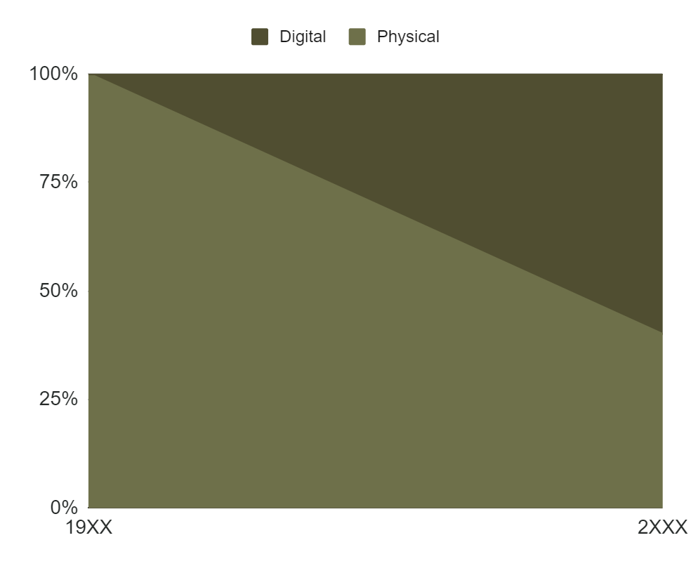
Middle Earth Fantasy Day infographics
Physical
Mercury is the smallest planet in the Solar System
Digital
Venus is extremely hot, even more than Mercury
Follow the link in the graph to modify its data and then paste the new one here. For more info, click here

Slide 22
Middle Earth Fantasy Day infographics
Mercury
Venus
It’s the smallest planet of them all
It’s the second planet from the Sun
Saturn
Neptune
It was named after a Roman god
Neptune is very far from the Sun
Jupiter
Mars
Jupiter is an enormous planet
Despite being red, Mars is cold

Slide 23
Middle Earth Fantasy Day infographics
vs.
30%
70%
Mercury
Saturn
Mercury is small
It’s the closest planet to the Sun
Saturn has rings
It was named after a Roman god

Slide 24
Middle Earth Fantasy Day infographics
Earth is the planet with life
Earth
Neptune
Neptune is very far from us
It doesn’t have a solid surface
Jupiter

Slide 25
Middle Earth Fantasy Day infographics
Mars
Saturn
Mars is full of iron oxide dust
Saturn has several rings
Earth
Jupiter
Earth is the planet with life
It doesn’t have a solid surface

Slide 26
Middle Earth Fantasy Day infographics
Venus is hot
Mars is cold
Jupiter is big
Venus
Mars
Jupiter
Pros
Books
Cons
Earth
Saturn
Mercury
Earth has life
It has rings
It’s small

Slide 27
Middle Earth Fantasy Day infographics
Mercury
2/5
Mercury is the smallest planet in the Solar System
Venus
4/5
Venus has a beautiful name, but also high temperatures
Jupiter
5/5
Jupiter is the biggest planet in the Solar System

Slide 28
Middle Earth Fantasy Day infographics
01
Venus
Venus is hot
02
Mars
Mars is cold
03
Jupiter
Jupiter is big
04
Saturn
Saturn has rings

Slide 29
Middle Earth Fantasy Day infographics
Mercury
Mars
Book 1
30%
Book 1
40%
Book 2
60%
Book 2
80%
Venus
Jupiter
Book 1
20%
Book 1
70%
Book 2
50%
Book 2
90%

Slide 30
Middle Earth Fantasy Day infographics
Venus
Venus is hot
Saturn
Mars
Neptune
Mars is cold
Jupiter
Jupiter is big

Slide 31
Middle Earth Fantasy Day infographics
Mercury
Mercury is the closest planet to the Sun
80%
Saturn
Saturn was named after a Roman god
40%
Earth
Earth is the third planet from the Sun
20%

Slide 32
Middle Earth Fantasy Day infographics
Venus
Venus is hot
Mars
Mars is cold
Jupiter
Jupiter is big
Saturn
80%
50%
30%
90%
Saturn has rings

Slide 33
Icon pack

Slide 34
Instructions for use
If you have a free account, in order to use this template, you must credit Slidesgo in your final presentation. Please refer to the next slide to read the instructions for premium users.
As a Free user, you are allowed to:
- Modify this template.
- Use it for both personal and commercial projects.
You are not allowed to:
- Sublicense, sell or rent any of Slidesgo Content (or a modified version of Slidesgo Content).
- Distribute Slidesgo Content unless it has been expressly authorized by Slidesgo.
- Include Slidesgo Content in an online or offline database or file.
- Offer Slidesgo templates (or modified versions of Slidesgo templates) for download.
- Acquire the copyright of Slidesgo Content.
For more information about editing slides, please read our FAQs or visit our blog:
https://slidesgo.com/faqs and https://slidesgo.com/slidesgo-school

Slide 35
Instructions for use (premium users)
As a Premium user, you can use this template without attributing Slidesgo.
You are allowed to:
Modify this template.
Use it for both personal and commercial purposes.
Share this template in an editable format with people who are not part of your team.
You are not allowed to:
Sublicense, sell or rent this Slidesgo Template (or a modified version of this Slidesgo Template).
Distribute this Slidesgo Template (or a modified version of this Slidesgo Template) or include it in a database or in any other product or service that offers downloadable images, icons or presentations that may be subject to distribution or resale.
Use any of the elements that are part of this Slidesgo Template in an isolated and separated way from this Template.
Register any of the elements that are part of this template as a trademark or logo, or register it as a work in an intellectual property registry or similar.
For more information about editing slides, please read our FAQs or visit our blog:
https://slidesgo.com/faqs and https://slidesgo.com/slidesgo-school

Slide 36
Infographics
You can add and edit some infographics to your presentation to present your data in a visual way.
Choose your favourite infographic and insert it in your presentation using Ctrl C + Ctrl V or Cmd C + Cmd V in Mac.
Select one of the parts and ungroup it by right-clicking and choosing “Ungroup”.
Change the color by clicking on the paint bucket.
Then resize the element by clicking and dragging one of the square-shaped points of its bounding box (the cursor should look like a double-headed arrow). Remember to hold Shift while dragging to keep the proportions.
Group the elements again by selecting them, right-clicking and choosing “Group”.
Repeat the steps above with the other parts and when you’re done editing, copy the end result and paste it into your presentation.
Remember to choose the “Keep source formatting” option so that it keeps the design. For more info, please visit our blog.

